Slide 1
FORCE AND LAWS OF MOTION

Slide 2

Exploring the World of Forces
What is a Force ?
Force is defined as an external cause that changes or tends to change the state of the body once applied
WHAT ARE THE LAWS OF MOTION?
FIRST LAW – First law of motion: An object continues to be in a state of
rest or of uniform motion along a straight line unless acted upon by an
unbalanced force.
SECOND LAW - The change rate of an object’s momentum is proportional to the applied unbalanced force in the direction of the force.
THIRD LAW - To every action, there is an equal and opposite reaction and they act on two different bodies.

Slide 3
CONTENTS
⁠Balanced and unbalanced forces
⁠First law of motion
⁠About Galileo Galilee
Inertia and mass
Second law of motion
⁠Mathematical formation of the second law of motion
⁠Third law of motion

Slide 4

Balanced Forces
Definition
Examples
Impact on Motion
Balanced forces occur when two or more forces acting on an object are equal in magnitude but opposite in direction. This results in a net force of zero.
When balanced forces act on an object, the object remains at rest or continues to move at a constant velocity. There is no change in the state of motion.
A book resting on a table experiences a balanced force. The downward force of gravity is balanced by the upward force of the table. Another example is a tug of war where both teams apply equal force.
300 NEWTON
300 NEWTON

Slide 5
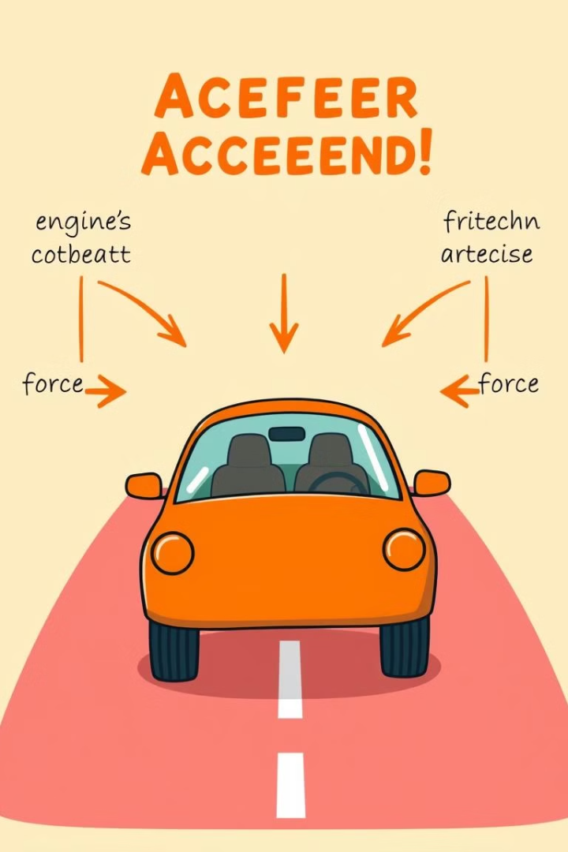
Unbalanced Forces
1
1. Definition
2
2. Impact on Motion
Unbalanced forces occur when the forces acting on an object are not equal in magnitude or direction, resulting in a non-zero net force.
Unbalanced forces cause a change in the object's state of motion. The object can accelerate, decelerate, or change direction.
3
3. Examples
Pushing a stationary object to make it move is an example. A car accelerating when the engine's forward force exceeds the frictional force is another example.

Slide 6
Inertia: The Resistance to Change
1
Concept of Inertia
2
Mass and Inertia
Inertia is the tendency of an object to resist changes in its state of motion. This means that an object at rest will resist being set in motion, and an object in motion will resist changes in its speed or direction.
The amount of inertia an object possesses is directly proportional to its mass. This means that heavier objects have more inertia and are harder to move or stop than lighter objects.
3
Examples of Inertia
4
Inertia in Everyday Life
When you push a heavy box across a room, you are overcoming its inertia. The box resists your push because it is trying to stay at rest. Similarly, when a car is braking, the passengers inside continue moving forward due to inertia until the seatbelts or airbags stop them.
Inertia is a fundamental concept that plays a role in many everyday phenomena. From the way a car responds to braking to the way a swing moves back and forth, inertia is a key factor in how objects move and interact with each other.

Slide 7



Understanding the Implications of Newton's First Law
Motion and Rest are Natural States
Inertia and Everyday Life
Importance of Understanding Inertia
Newton's First Law implies that motion and rest are natural states of objects, and it is the presence of an external force that causes a change in motion.
Inertia is a fundamental concept that plays a role in many everyday phenomena. From the way a car responds to braking to the way a swing moves back and forth, inertia is a key factor in how objects move and interact with each other.
Understanding inertia is crucial in many fields, including engineering, transportation, and even sports. By understanding how inertia works, we can design safer cars, build more efficient machines, and improve athletic performance.

Slide 8




The Laws of Motion and Gravitation
Uniform Motion
Accelerated Motion
The Law of Universal Gravitation
Galileo discovered that an object in motion continues to move at a constant velocity unless an external force is applied.
Galileo discovered that the velocity of an object in free fall increases constantly, with a constant acceleration due to the force of gravity.
Inspired by Galileo, Isaac Newton formulated the law of universal gravitation, which describes the gravitational attraction between all objects in the universe.

Slide 9
Definition of inertia and mass
Mass
Inertia
A fundamental property of matter, representing the amount of matter an object contains. Mass is a scalar quantity, meaning it only has magnitude.
The tendency of an object to resist changes in its state of motion. Inertia is directly proportional to mass, meaning a more massive object will have greater inertia.

Slide 10
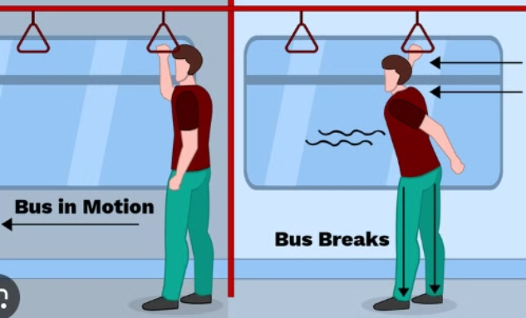

Relation between inertia and mass
Direct Proportionality
Newton's First Law
As the mass of an object increases, its inertia increases proportionally. This means a more massive object will resist changes in motion more strongly.
Inertia is described by Newton's First Law of Motion, which states that an object at rest will stay at rest and an object in motion will stay in motion at a constant velocity unless acted upon by a net external force.

Slide 11

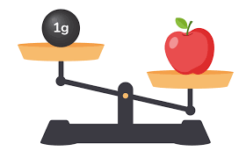
Example of inertia, mass
1
Raindrops and Umbrella
Raindrops falling vertically maintain their direction due to inertia. An umbrella acts as a force, changing the direction of the raindrops, causing them to slide along the surface.
2
Apple and 1 gram
Raindrops falling vertically maintain their direction due to inertia. An umbrella acts as a force, changing the direction of the raindrops, causing them to slide along the surface.

Slide 12

The Second Law of Motion
The Second Law of Motion describes the relationship between an object's acceleration, the net force acting upon it, and the object's mass. It is a fundamental principle that governs the motion of all objects in the physical world.

Slide 13
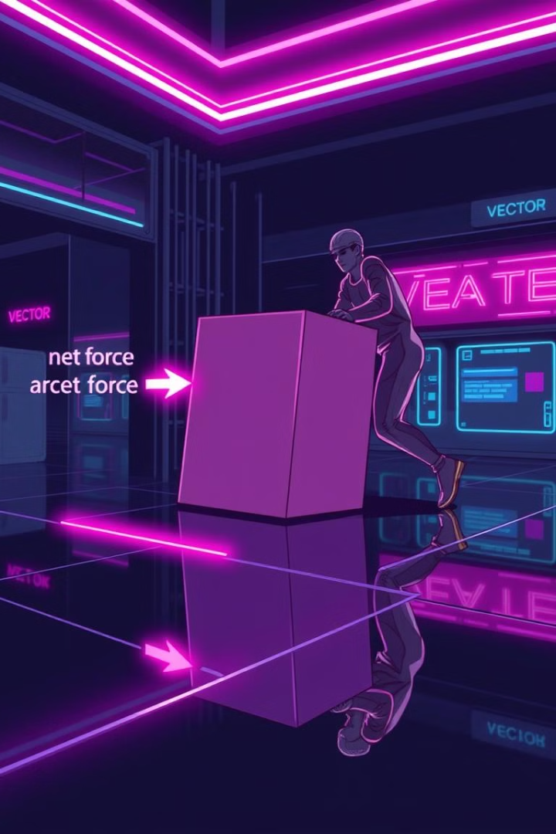
Acceleration and Net Force
1
Net Force
The net force is the vector sum of all the forces acting on an object.
2
Acceleration
The acceleration of an object is directly proportional to the net force acting on it and inversely proportional to its mass.
3
Relationship
The Second Law states that the acceleration of an object is directly proportional to the net force acting on it and inversely proportional to its mass.

Slide 14

Quantifying the Second Law
Equation
Units
The Second Law can be expressed mathematically as: F = ma, where F is the net force, m is the object's mass, and a is the acceleration.
The units for force, mass, and acceleration are Newtons (N), kilograms (kg), and meters per second squared (m/s²), respectively.
Rearrangement
Limitations
The equation can be rearranged to solve for any of the three variables, depending on the problem being addressed.
The Second Law assumes that the forces acting on an object are constant and that the object's mass is also constant.

Slide 15




Implications and Examples
Rocket Propulsion
Gravity and Acceleration
The Second Law explains how rockets are able to accelerate and achieve high speeds by generating a large net force.
The Second Law governs the acceleration of objects due to gravity, such as a falling object or a projectile in motion.
Vehicle Dynamics
Biomechanics
The Second Law is crucial in understanding the acceleration and braking of vehicles, which is essential for transportation engineering and safety.
The Second Law can be applied to the motion of the human body, such as the acceleration of a limb during a physical activity.

Slide 16
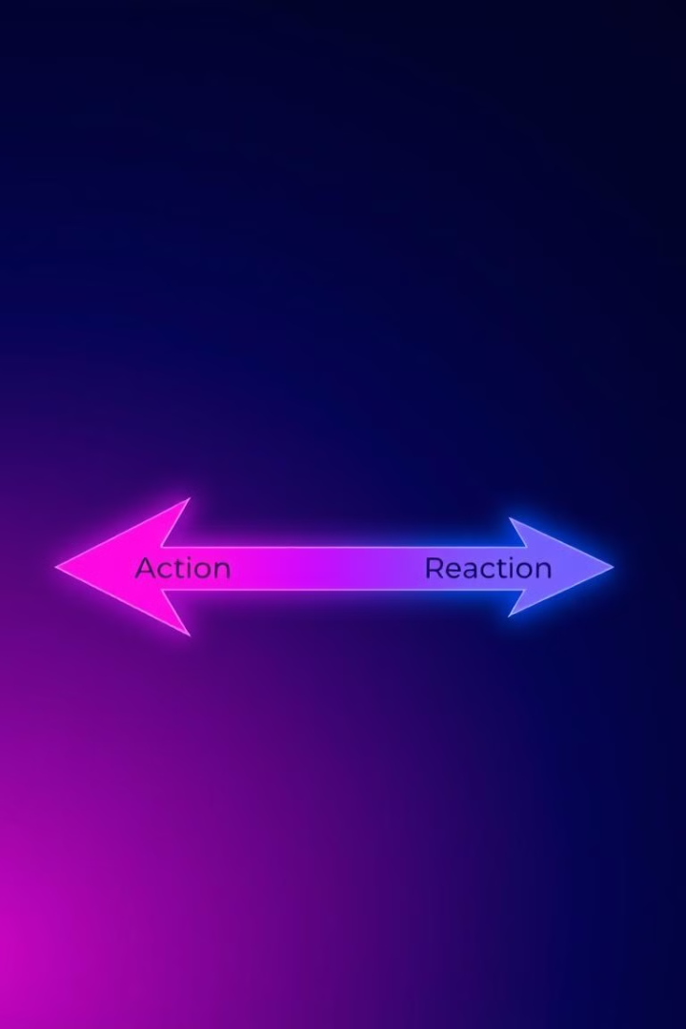
The Third Law of Motion
Newton's Third Law of Motion states that for every action, there is an equal and opposite reaction. This fundamental principle of physics governs the interactions between objects and helps explain a wide range of phenomena in the natural world.

Slide 17



Newton's Third Law in Action
Pushing a Wall
Throwing a Ball
When you push against a wall, the wall exerts an equal and opposite force back on your hand.
When you throw a ball, the ball exerts a force back on your hand, causing your hand to recoil slightly.
Jumping
As you push off the ground, the ground pushes back up on your feet with the same force, propelling you into the air.

Slide 18

Understanding the Third Law
Forces in Pairs
Magnitude and Direction
The Third Law states that forces always come in pairs - equal action and reaction forces that act on different objects.
The action and reaction forces have the same magnitude but act in opposite directions on the two interacting objects.
Real-World Applications
Understanding the Third Law is crucial for explaining phenomena in fields like engineering, sports, and transportation.

Slide 19
THANK YOU
Our Team Members:-
NATHUL
HARI
KAASI
SURYA
RUDHRESH
KIRUTHIK PRANAV
PAVAN BALA
SANJITH RAM

